Slide 1




Xiamen University
Optimally Secure Tweakable Block Ciphers with a Large Tweak from $n$-bit Block Ciphers
Yaobin Shen and François-Xavier Standaert
March 27, FSE 2024 @Leuven

Slide 2










Block Cipher and Tweakable Block Cipher
Block Cipher (BC): a random permutation for a secret key
Tweakable Block Cipher (TBC): a random permutation for a pair of key and tweak $(k,t)$
  key is secret to provide security
  tweak is public to provide flexibility
$$k$$
$$k$$
$$m$$
$$E$$
$$c$$
$$m$$
$$\tilde{E}$$
$$c$$
$$t$$
block cipher
tweakable block cipher

Slide 3








Approaches to Design TBC
Dedicated constructions
  Hasty Pudding Cipher [SO98]
  Mercy [Cro00]
  Skinny [BJK+16]
  Deoxys-BC [JNPS21]
Modular designs: design a TBC from a BC
  generic, reduce the security of TBC to BC
  the transformation is important (provable security)
$$k$$
$$k$$
transformation
$$m$$
$$E$$
$$c$$
$$m$$
$$\tilde{E}$$
$$c$$
$$t$$
block cipher
tweakable block cipher

Slide 4











Example: LRW1 and LRW2
LRW1 and LRW2 by Liskov et al. [LRW02]
$H$ is a almost-xor-universal (AXU) hash function
Birthday-bound security $2^{\frac{n}{2}}$
$$k$$
$$t$$
$$k$$
$$H_{l}(t)$$
$$k$$
$$H_{l}(t)$$
$$m$$
$$E$$
$$E$$
$$c$$
$$m$$
$$E$$
$$c$$

Slide 5
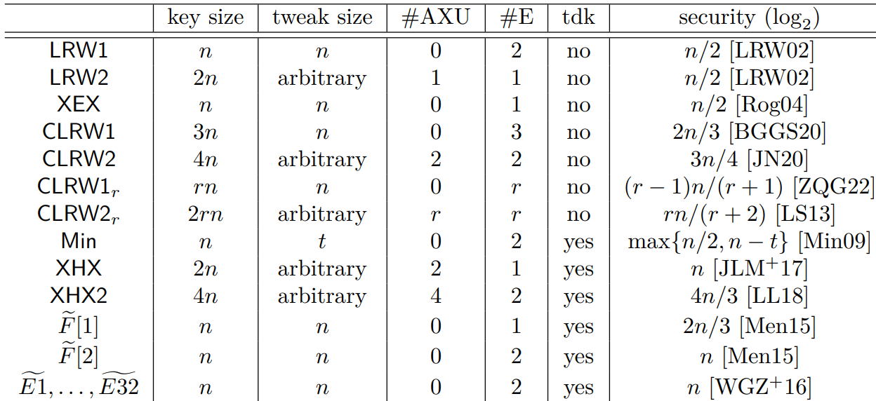
State of the Art
To support more than $n$-bit tweak, all existing schemes require an additional primitive called universal hash to compress the tweak

Slide 6
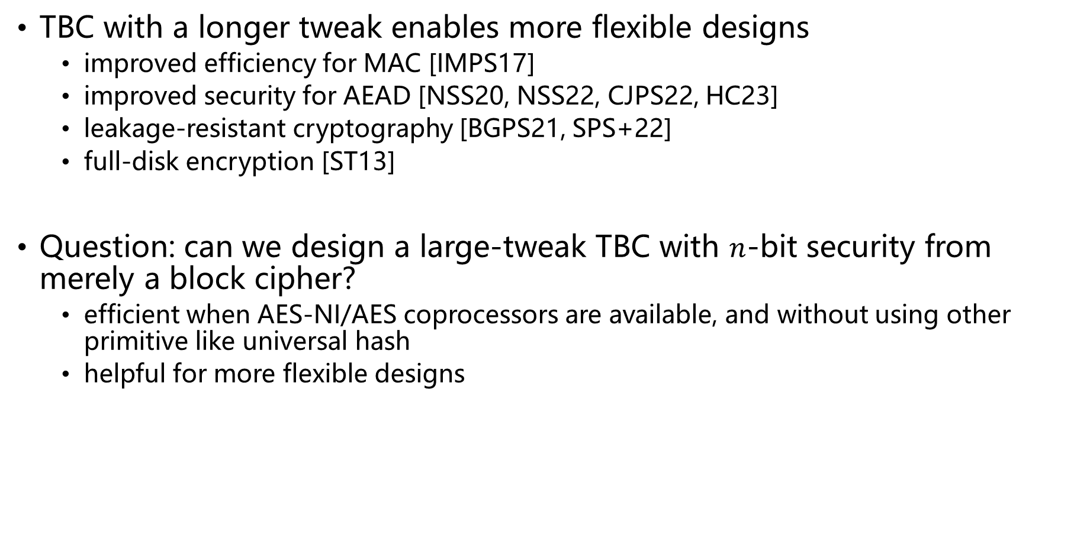
TBC with a Longer Tweak
TBC with a longer tweak enables more flexible designs
  improved efficiency for MAC [IMPS17]
  improved security for AEAD [NSS20, NSS22, CJPS22, HC23]
  leakage-resistant cryptography [BGPS21, SPS+22]
  full-disk encryption [ST13]
Question: can we design a large-tweak TBC with $n$-bit security from merely a block cipher?
  efficient when AES-NI/AES coprocessors are available, and without using other primitive like universal hash
  helpful for more flexible designs

Slide 7
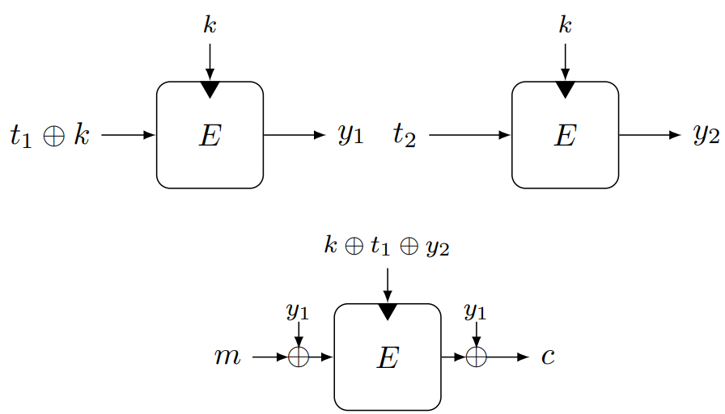

Our Contributions
We investigate how to design a TBC with $2n$-bit tweak and $n$-bit security from two block cipher calls
  we show all of these constructions suffer from birthday-bound attacks
We propose a TBC construction called $\tilde{G}2$ supporting $2n$-bit tweak with $n$-bit security from three block cipher calls

Slide 8



















TBC from Two BC Calls
TBCs from one BC call at most $2^{\frac{n}{2}}$ secure [Men15]
TBCs from two BC calls can achieve $n$-bit security but only support $n$-bit tweak [WGZ+16]
Can we extend TBCs from two BC calls to $2n$-bit tweak?
$$a_{1,1}⋅k$$
$$a_{1,2}⋅t$$
$$a_{2,1}⋅k$$
$$a_{2,2}⋅t$$
$$a_{2,3}⋅y_{1}$$
$$b_{2,4}⋅y_{1}$$
$$b_{3,5}⋅y_{2}$$
$$b_{1,1}⋅k$$
$$E$$
$$E$$
$$c$$
$$b_{2,1}⋅k$$
$$b_{3,1}⋅k$$
$$b_{1,2}⋅t$$
$$b_{3,2}⋅t$$
$$b_{2,2}⋅t$$
$$b_{3,3}⋅m$$
$$b_{1,3}⋅m$$
$$b_{2,3}⋅m$$
$$b_{3,4}⋅y_{1}$$
Two-BC framework in [WGZ+16]

Slide 9
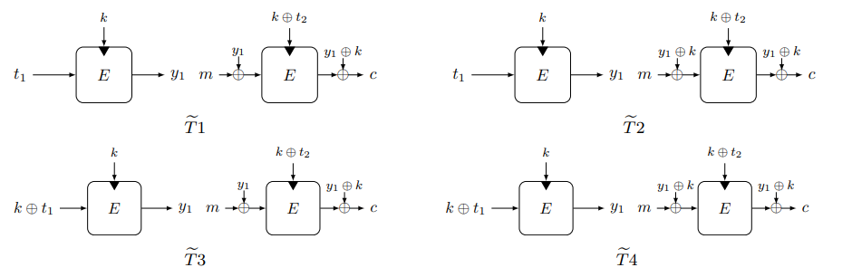

First category with One Tweak-Dependent Key
[WGZ+16] exhaustively found 56 TBCs can achieve $n$-bit security with $n$-bit tweak
For constructions that are different from these 56 TBCs with $2n$-bit tweak, we can set the $2n$-bit tweak $t_{1}||t_{2}$ to $t_{1}=t_{2}=t$
Among these 56 TBCs, only 4 TBCs have two positions that can occupy $2n$-bit tweak
Birthday-bound attacks exist
Notes:
TBCs from two BC calls can be classified into two categories [WGZ+16]

Slide 10
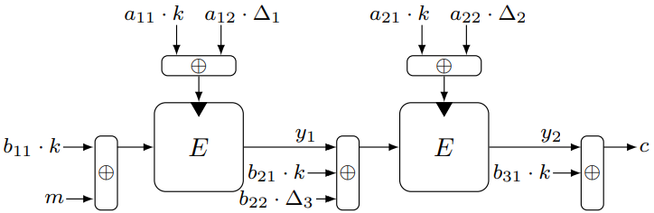
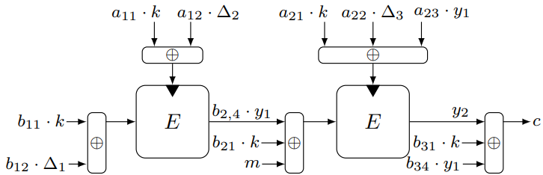
Second Category with Two Tweak-dependent Keys
The second category can be further divided into three types
  Type III is trivially insecure
We perform an exhaustive search and find all of these constructions are subject to birthday-bound attacks
Type I constructions
Type II constructions
$Δ_{1},Δ_{2},Δ_{3}$ represent three positions for the tweak. In [WGZ+16], they consider the cases $Δ_{1}=Δ_{2}=Δ_{3}=t$

Slide 11





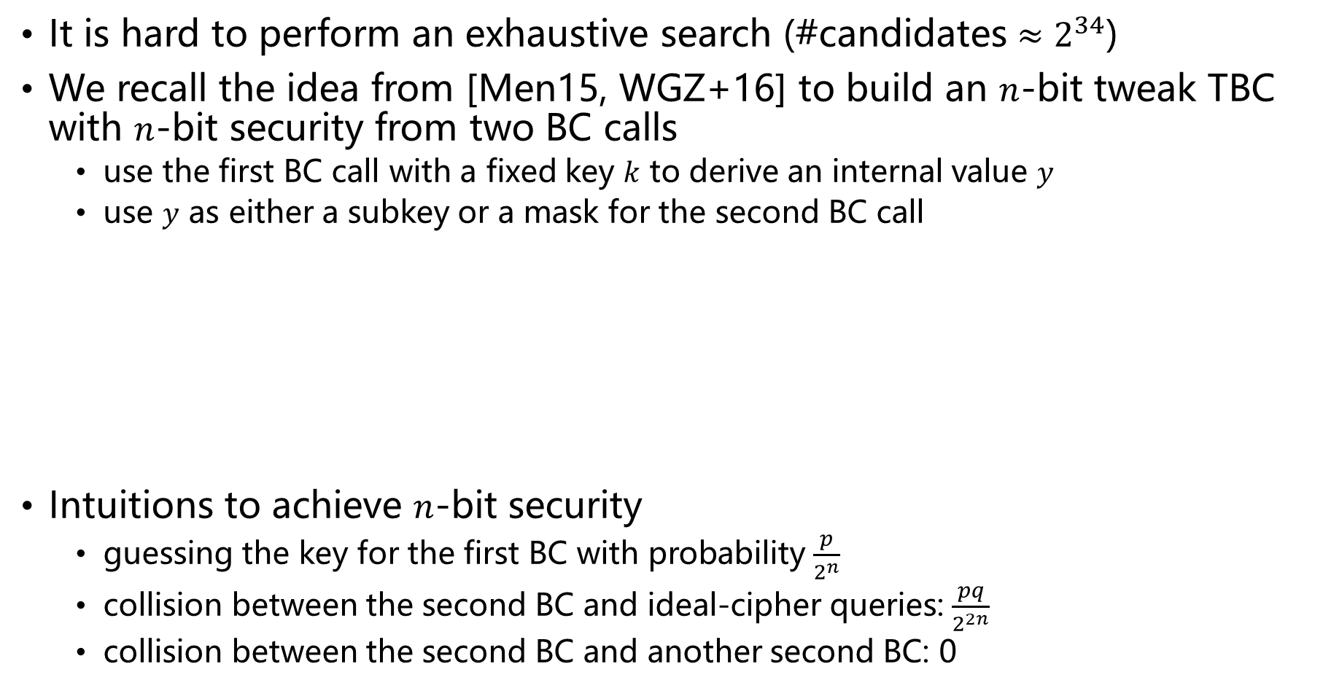




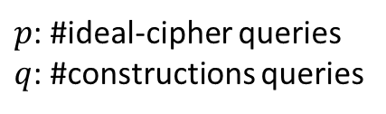
TBC from Three BC Calls
It is hard to perform an exhaustive search (#candidates $≈2^{34}$)
We recall the idea from [Men15, WGZ+16] to build an $n$-bit tweak TBC with $n$-bit security from two BC calls
  use the first BC call with a fixed key $k$ to derive an internal value $y$
  use $y$ as either a subkey or a mask for the second BC call
Intuitions to achieve $n$-bit security
  guessing the key for the first BC with probability $\frac{p}{2^{n}}$
  collision between the second BC and ideal-cipher queries: $\frac{pq}{2^{2n}}$
  collision between the second BC and another second BC: 0
$$k$$
$$y$$
$$k⊕t$$
$$y⊕k$$
$$0$$
$$E$$
$$y$$
$$m$$
$$E$$
$$c$$
Example: $\tilde{E1}$ in [WGZ+16]
$p$: #ideal-cipher queries
$q$: #constructions queries

Slide 12
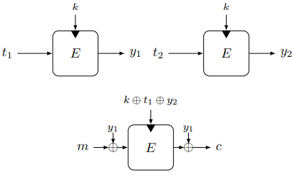
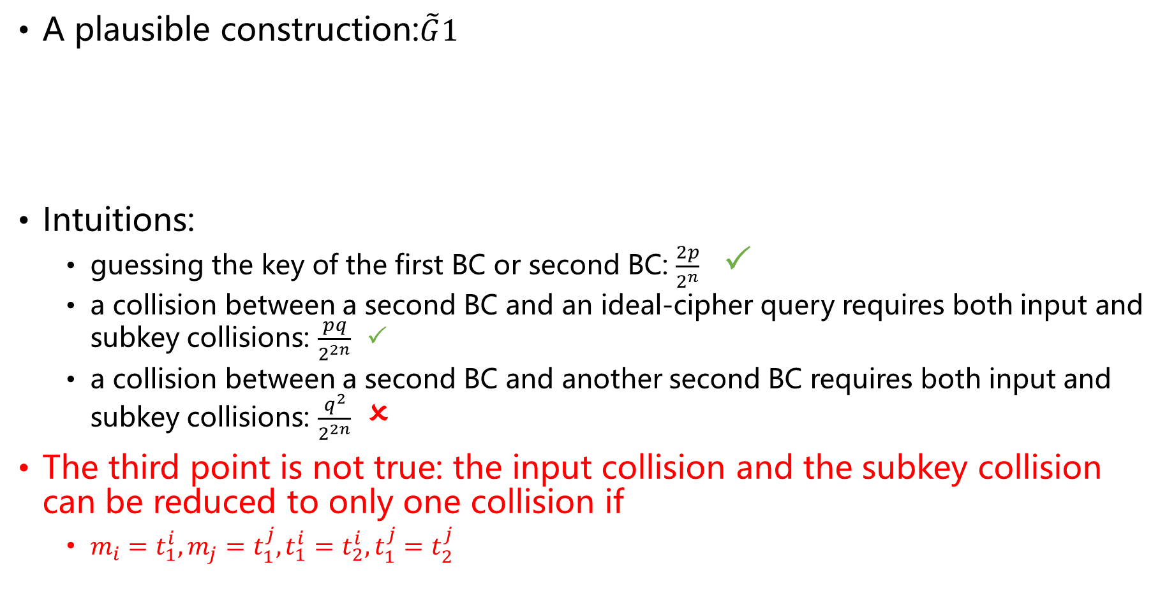
First attempt
A plausible construction:$\tilde{G}1$
Intuitions:
  guessing the key of the first BC or second BC: $\frac{2p}{2^{n}}$ 
  a collision between a second BC and an ideal-cipher query requires both input and subkey collisions: $\frac{pq}{2^{2n}}$ 
  a collision between a second BC and another second BC requires both input and subkey collisions: $\frac{q^{2}}{2^{2n}}$ 
The third point is not true: the input collision and the subkey collision can be reduced to only one collision if
  $m_{i}=t_{1}^{i},m_{j}=t_{1}^{j},t_{1}^{i}=t_{2}^{i},t_{1}^{j}=t_{2}^{j}$

Slide 13
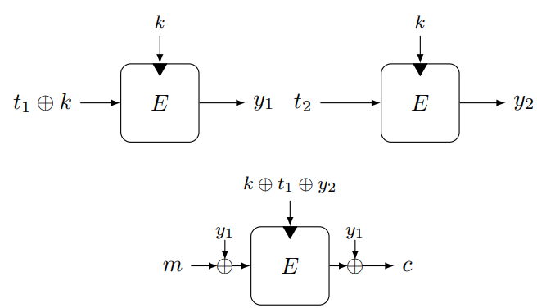
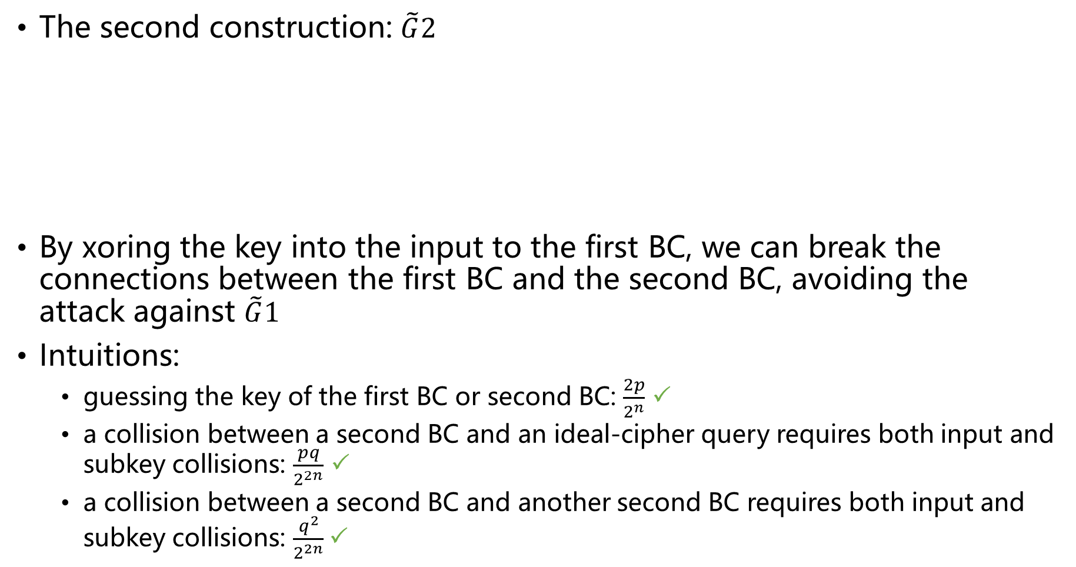
Second construction
The second construction: $\tilde{G}2$
By xoring the key into the input to the first BC, we can break the connections between the first BC and the second BC, avoiding the attack against $\tilde{G}1$
Intuitions:
  guessing the key of the first BC or second BC: $\frac{2p}{2^{n}}$ 
  a collision between a second BC and an ideal-cipher query requires both input and subkey collisions: $\frac{pq}{2^{2n}}$ 
  a collision between a second BC and another second BC requires both input and subkey collisions: $\frac{q^{2}}{2^{2n}}$

Slide 14






Provable Security
Ideal-cipher model
Information-theoretic indistinguishability
  $\tilde{π}$ tweakable random permutation
  $E$ ideal cipher
$$\tilde{G}2^{±}$$
$$E^{±}$$
$${\tilde{π}}^{±}$$
$$E^{±}$$
distinguisher $𝒟$

Slide 15
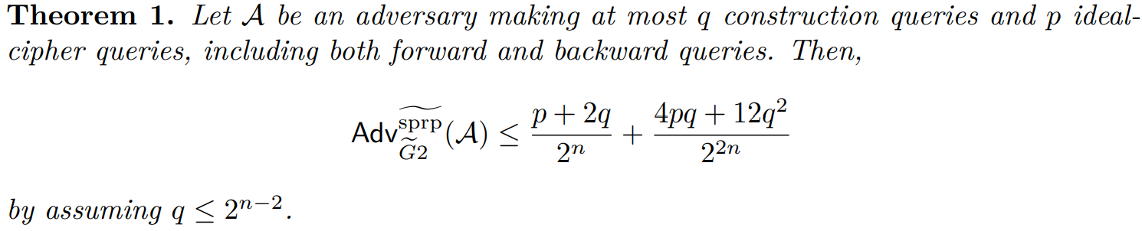
$n$-bit security of $\tilde{G}2$

Slide 16
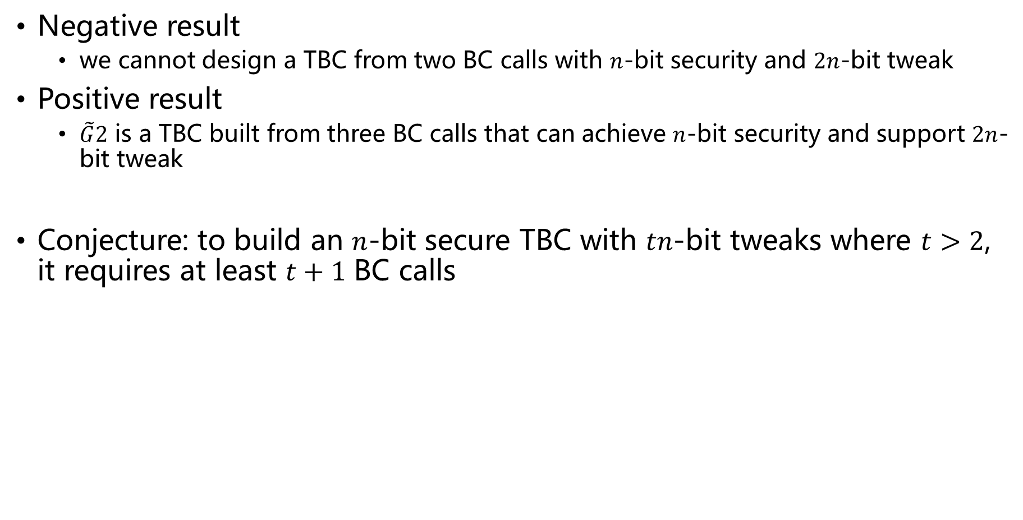
Conclusions
Negative result
  we cannot design a TBC from two BC calls with $n$-bit security and $2n$-bit tweak
Positive result
  $\tilde{G}2$ is a TBC built from three BC calls that can achieve $n$-bit security and support $2n$-bit tweak
Conjecture: to build an $n$-bit secure TBC with $tn$-bit tweaks where $t>2$, it requires at least $t+1$ BC calls

Slide 17
Thanks

