Slide 1
Towards Low Energy Stream Ciphers

Slide 2
Contents
Introduction
Comparison of Stream Ciphers with Block Ciphers
Energy-Impact of Stream Ciphers Design Components
Conclusion

Slide 3
Introduction

Slide 4

Introduction
Energy is the time integral of power
Energy is linked to total electric work done
Applications:
  Battery operated devices
  Body implants
  IoT devices
$$E=\int_{t}{Pdt}$$

Slide 5
Design goals
Security
Increase throughput:
  use more resources
↑Throughput
↓Area/Power
Reduce power/area:
  apply simpler operations but large number times

Slide 6
Optimizing energy
Security
↑Throughput
↓Area↔Power
Optimize energy efficiency?

Slide 7
Optimizing energy
Main principle:
  increase throughput by larger factor than increasing power
  or reduce power by larger factor than throughput
Security
↑Throughput
Area↔↓Power
Energy efficiency

Slide 8
Current state of the art
Many cipher proposals aim for low area
Several designed for low power (but not energy!)
Energy efficiency of block ciphers:
  Banik, et al. "Exploring energy efficiency of lightweight block ciphers“, SAC, 2015.
  Banik, et al. ”Midori: A Block Cipher for Low Energy “, AsiaCrypt , 2015
Energy efficiency of stream ciphers not well investigated
Our goal: investigate impact of different designs on energy consumption

Slide 9
Comparison of stream ciphers with block ciphers

Slide 10
Stream ciphers vs Block Ciphers
Common believe:
  “Because of long initialization phase stream ciphers are less energy efficient than block ciphers unless huge amounts of data are to be encrypted”
Is this true?

Slide 11
Analyzed ciphers
Stream ciphers
  Grain v1 and Grain 128
    e-stream hardware portfolio
    shortest state state size with classical design approach
  Trivium
    e-stream hardware portfolio
    large state size, but very simple update
  Kreyvium
    Trivium providing 128-bit security
    two additional registers for key and IV rotation, and two additional xor gates,
  Plantlet
    keyed update
    shorter interrnal state size
  Lizard
    recent stream cipher designed for low-power
    low state size + second key addition
    complicated functions
Block ciphers
  Present
    a standard in ISO/IEC 29192-2
    was shown to be extremely energy efficient.
  Midori 64
    was designed specifically for low energy consumption

Slide 12
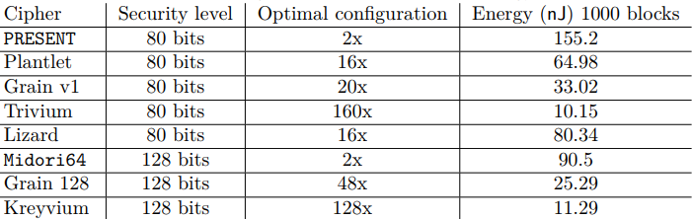
Best cipher configurations with respect to energy consumption
Trivium (160x) is 9 times more energy efficient than the best Midori64 implementation when encrypting large amounts of data.

Slide 13
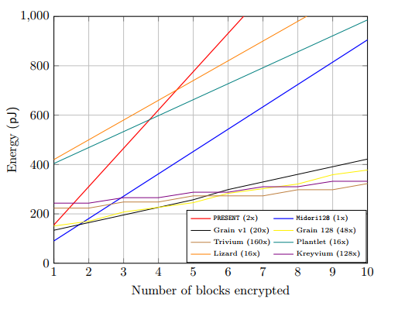
Comparison with block ciphers
Midori64 has the best energy efficiency if 1 block has to encrypted
For 2 blocks of data (128 bits) Grain v1(20x) and Grain 128 (48x) have the lowest energy consumption
After 6 blocks of data Trivium performs best
*
*1 block = 64 bits

Slide 14
Energy Impact of Design Components
Unrolling rounds

Slide 15
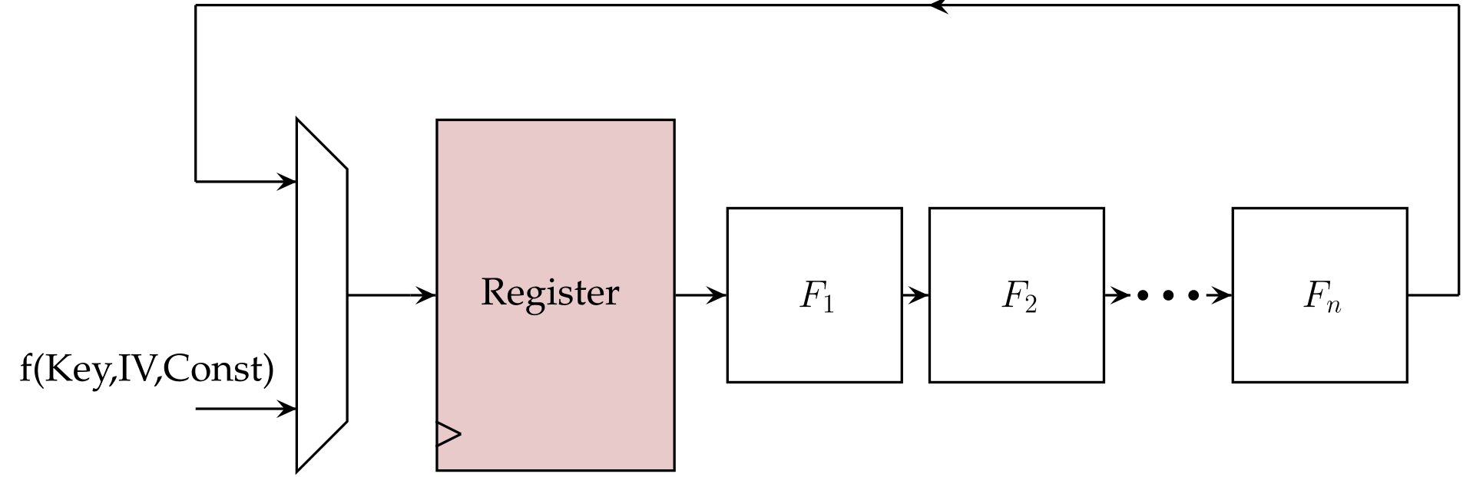
Unrolling rounds
Aim: increase throughput at the cost of area
Replace logic designed for one round by the one which implements several rounds

Slide 16
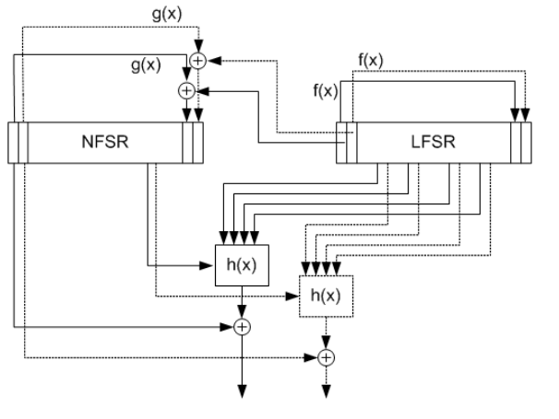
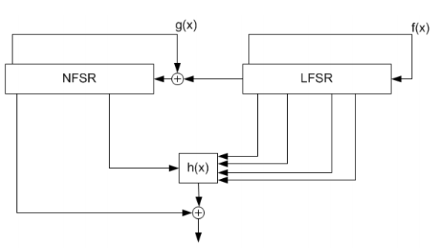
Unrolling rounds (2)
Grain v.1
No copies of registers are necessary
1 bit/clock-cycle version
2 bit/clock-cycle version

Slide 17
Unrolling rounds (3)
Many modern stream ciphers were designed to allow easy unrolling
E.g. last 16 bits in both registers of Grain v1 are used neither in the update nor in the output function
This implies that a 16x unrolling of Grain v1 is straightforward
  only requires 16 additional copies of the round and update functions to be added to the circuit

Slide 18
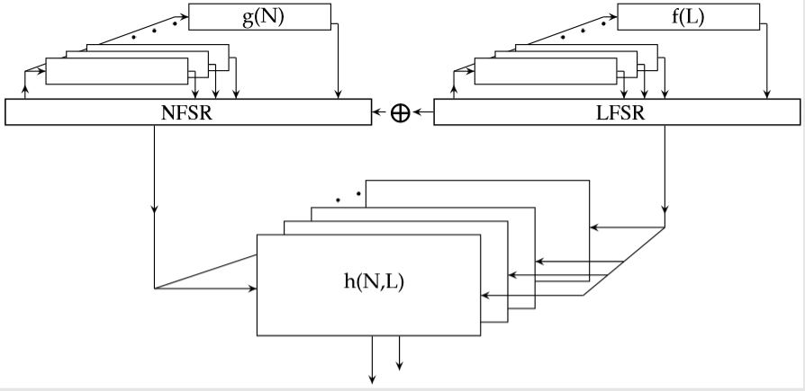
Unrolling rounds (4)
Grain v.1
16 bits/clock-cycle version
Further unrolling is possible but requires more complicated algebraic structure of update functions
  simply adding more copies of round functions will no longer lead to correct functionality.

Slide 19
Unrolling rounds (5)
At some point the power consumed in the logic functions increases sharply
Beyond a certain degree of unrolling, increasing the unrolling results into an increase of energy consumption

Slide 20
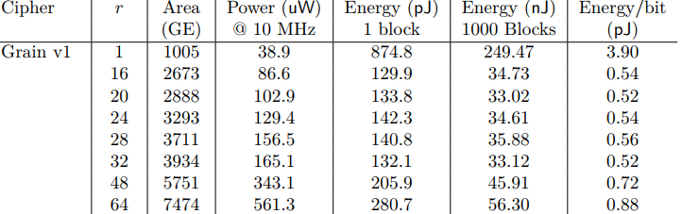
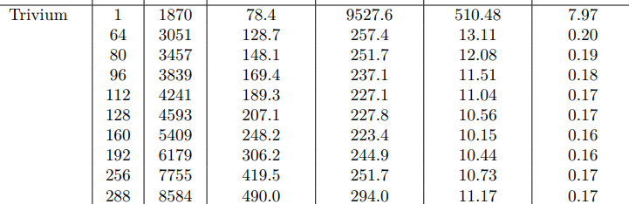
Parabolic behavior with unrolling
r = degree of unrolling
Reason: Trivium uses extremely simple round update functions

Slide 21
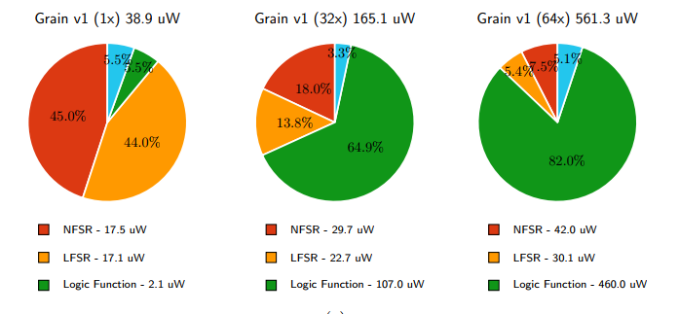
Power consumption shares of Grain v1 for different degrees of unrolling
With the increase of degrees of unrolling the most power hungry element becomes the round function.

Slide 22
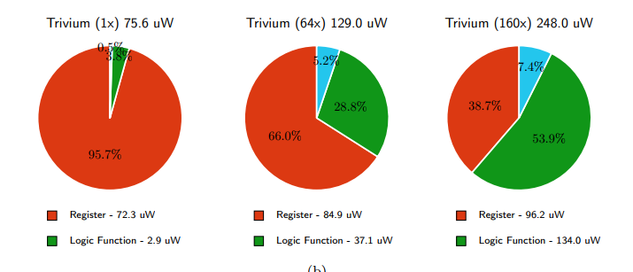
Power consumption shares of Trivium for different levels of unrolling
Lessons learned:
  Use simple update function
  State size not so relevant

Slide 23
Energy Impact of Design Components
Architecture

Slide 24
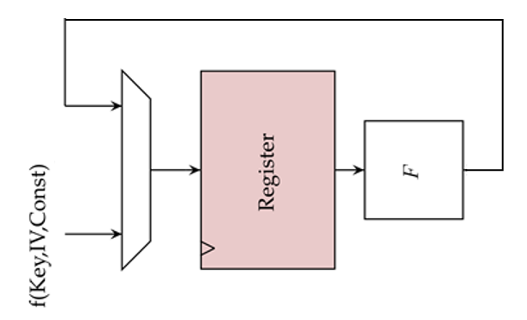
Architecture:
Scan flip-flops vs regular ones (1)
At first register is initialized by combination of the key and IV
After that it is fed by the output of round function.
For selection multiplexers are usually placed before flip-flops
The combination of flip-flop and multiplexer can be replaced with a scan flip-flop
Multiplexers
Flip-flops

Slide 25
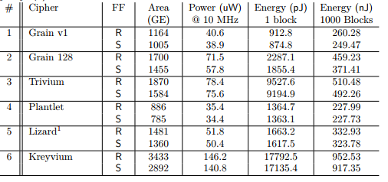
Architecture:
Scan flip-flops vs regular ones (2)
Lesson learned: Use scan flip-flops
FF = flip flop type, R = regular flip flops. S = scan flip flops

Slide 26
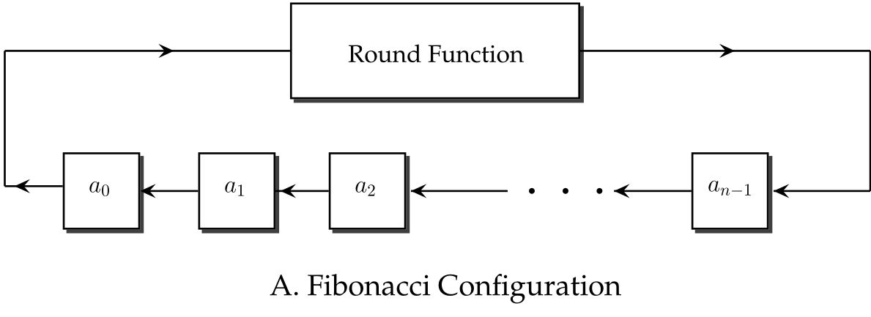
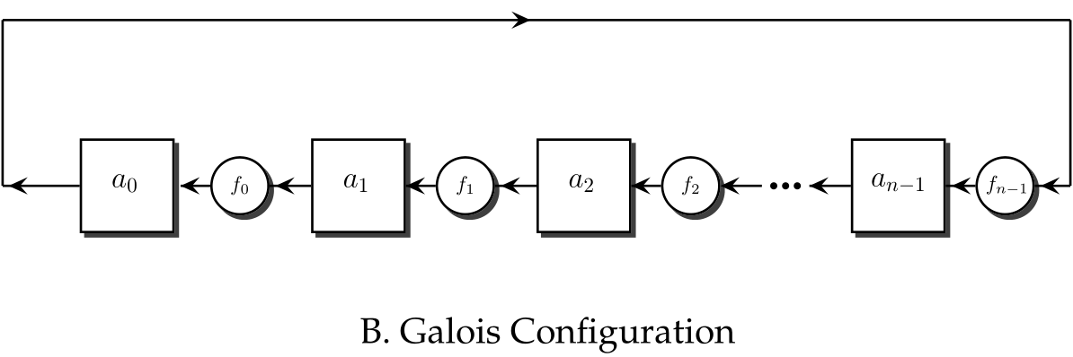
Architecture:
Fibonacci vs Galois FSRs(1)

Slide 27
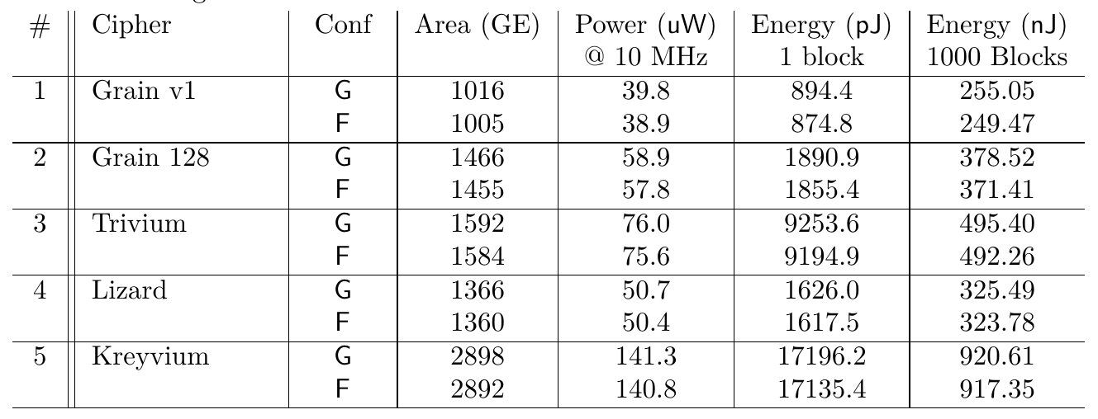
Architecture:
Fibonacci vs Galois FSRs(2)
No significant difference
Lesson learned: Use Fibonacci FSRs to allow easier unrolling

Slide 28
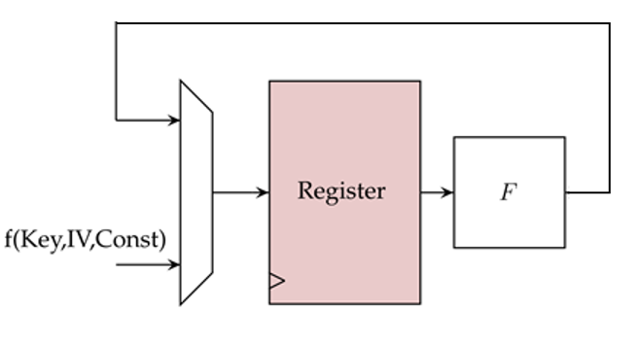

Architecture:
Implementation of round function
Implementation of $F$:
  A) Look-up table
  B) Give functional description to synthesizer and let it optimize
  C) Using Decoder-Switch-Encoder (DSE) configuration

Slide 29
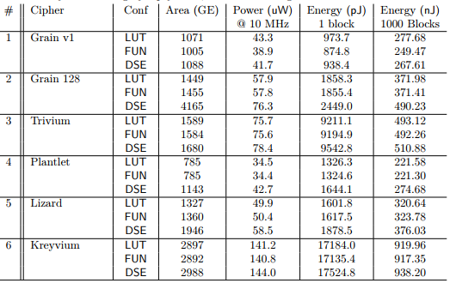

Architecture:
Implementation of round function
Lesson learned: Let synthesizer optimize $F$

Slide 30
Lessons learned:
Architecture:
  Scan flip-flops
  Fibonacci configuration
  Let synthesizer to optimize update mapping
Rounds unrolling:
  Simple update functions
  State size less important
  Initialization time effect becomes minimal with the increase in the length of data

Slide 31
Conclusion

Slide 32
Conclusion
Various design parameters were investigated
For longer data streams multiple round unrolled stream ciphers perform better than block ciphers
Simple update functions is the key to
energy-efficiency (easy unrolling)

Slide 33
Further steps
More energy efficient designs (?)
Optimize energy under certain constraints
  Limited area size
  Limited power consumption
  Fixed throughput

Slide 34
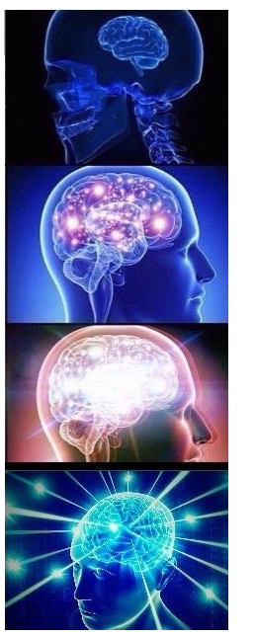
Questions?
Increase throughput
Reduce area/power
Optimize energy
Stay secure

